Slide 1
Topologies
Bus
Ring
Star
Mesh
Tree

Slide 2
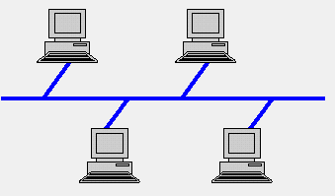
Bus Topology
A bus topology is a multiple data communication circuit, that makes it relatively simple to control data flow.
A bus topology consists of a single cable with the terminator at each end.
In a bus topology, one of the nodes acts as the server and transmits the data from one end to the other in a single direction.
The Backbone cable in the bus topology depends on the type of network card used in each computer, an RJ-45 network cable or coaxial cable is used to connect them together.

Slide 3
Advantages:-
The cable cost is low.
Easy to expand.
Repeater can be used to boost the signal.
Easy to connect or remove devices in a network without affecting any other device.
Disadvantage:-
Heavy network traffic slows down the bus speed.
In the case of any device failure, it is difficult to find faults in a network.
It is slower because one computer transmits at a time.
It provides very low security because all the computers receive the sent signal from the source.

Slide 4
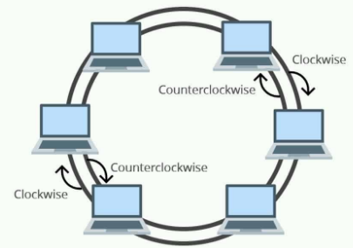
Ring Topology
In Ring Topology, each device/node is connected with its neighboring node forming the shape of ring hence it is known as Ring Topology.
There are two types of the Ring Topology based on the data flow:
Unidirectional and,
Bidirectional
A Unidirectional ring topology handles data traffic in either
clockwise or anticlockwise direction. This data network,
thus, can also be called as a half-duplex network.
A Unidirectional ring topology is thus easy to maintain
compared to the bidirectional ring topology.
The data flow in the ring topology is based on the Token Passing principal, The token is passed from one computer to the next, only the computer with the token can transmit.

Slide 5
Advantages:-
The uni-directional ring topology provides very high speed.
It has better performance than bus topology, even when the nodes are increased.
Ring network can handle high volume of nodes in a network (Robust)
It can handle heavy traffic as compared to bus topology due to Token passing.
provides good communication over a long distance.
maintenance of ring network is much easier than bus.
no need of network server to control the flow of data.
Disadvantages:-
Addition and removal of any node in a network is difficult and can cause issue in network activity.
The entire network will be impacted if one workstation shuts down.
The hardware needed to connect each workstation to the network is more expensive than Ethernet cards and hubs/switches.

